Slide 1
Tourist Guide

Slide 2
Group Members
AKHIRUL ISLAM
ID: 19-41208-2
S M TUSHER MUSTAKIM
ID: 19-40861-2
FARZANA KARIM MIM
ID: 19-40966-2
MD.METHUN
ID: 19-41239-2

Slide 3
REQUIRMENT ANALYSIS
How does It work
How to use
Target user
User opportunities

Slide 4
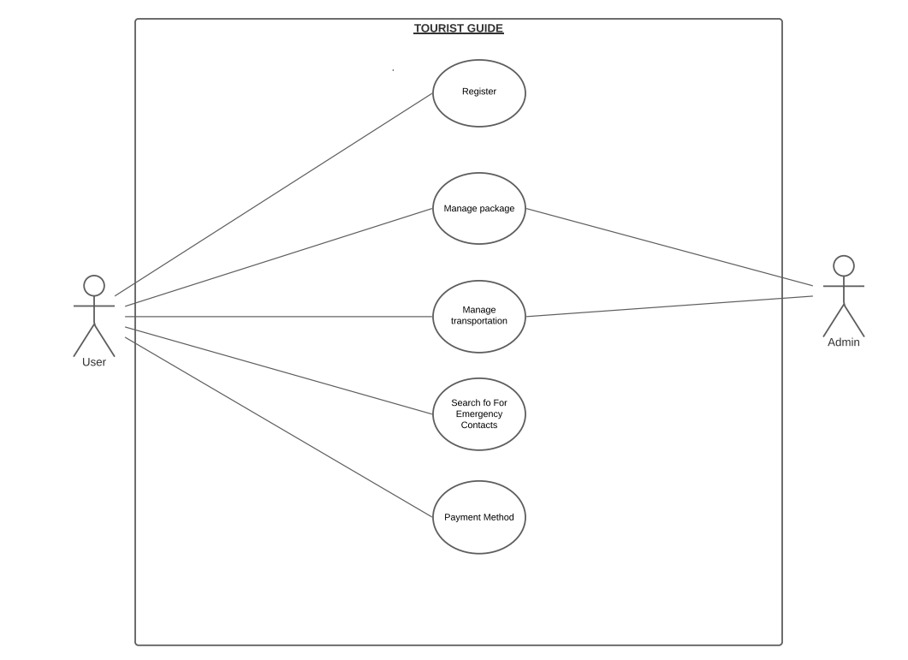
USE CASE DIAGRAM

Slide 5
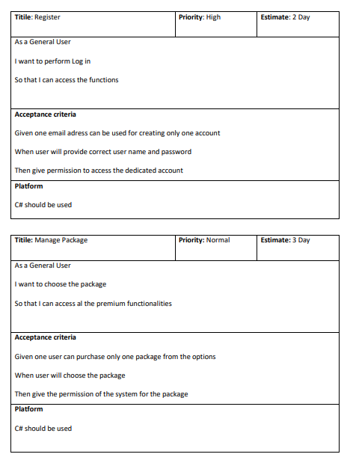
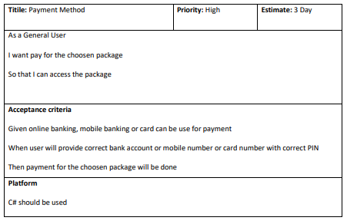
USER STORY TEMPLATE

Slide 6
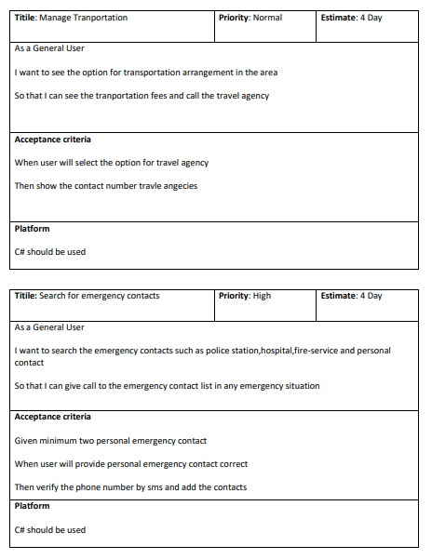
USER STORY TEMPLATE

Slide 7
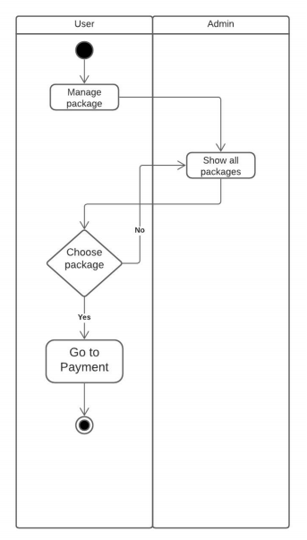
ACTIVITY DIAGRAM-1

Slide 8
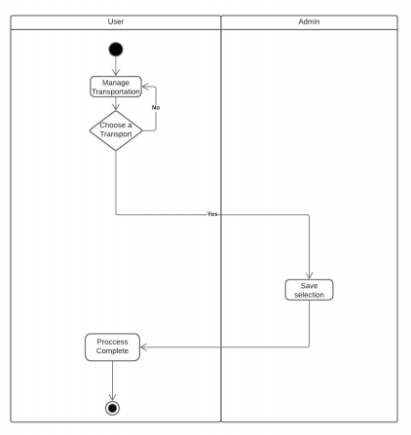
ACTIVITY DIAGRAM-2

Slide 9
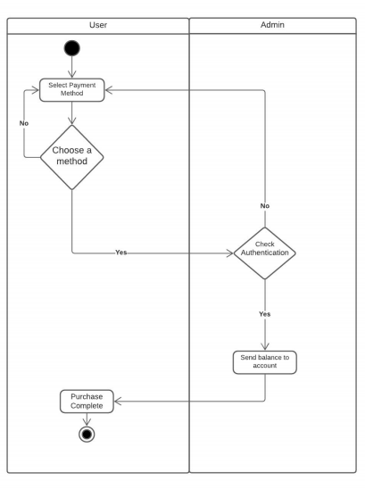
ACTIVITY DIAGRAM-3

Slide 10
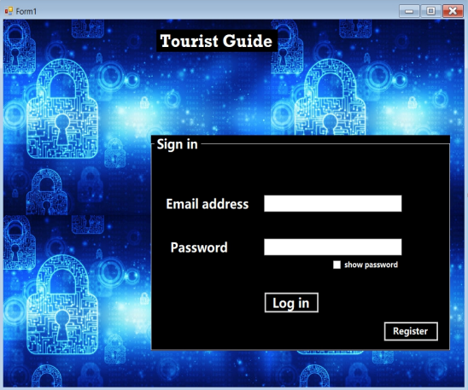
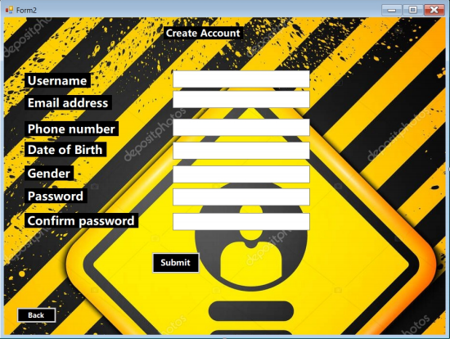
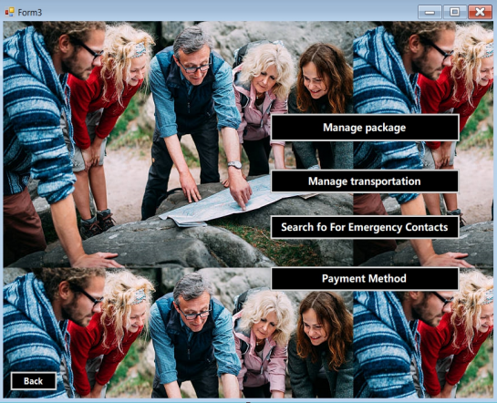
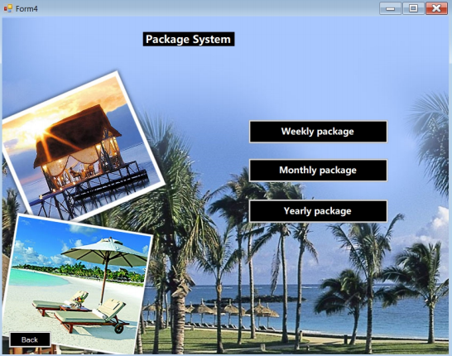
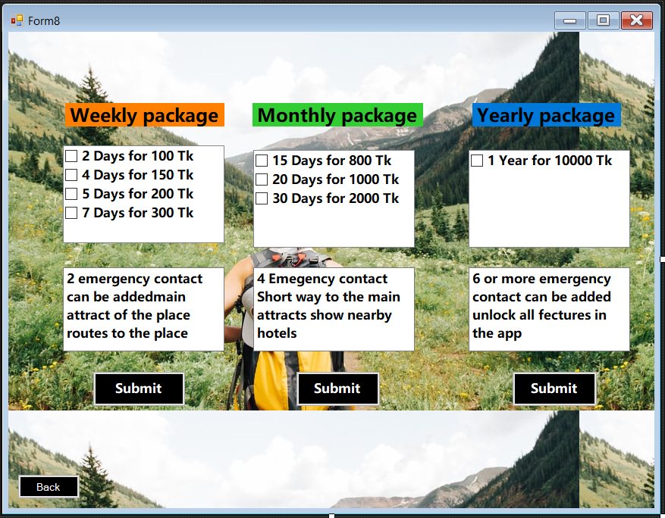
MOCK DESIGN

Slide 11
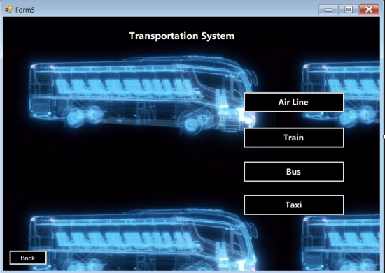
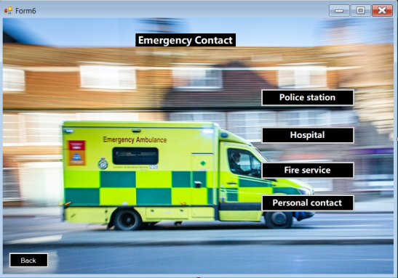
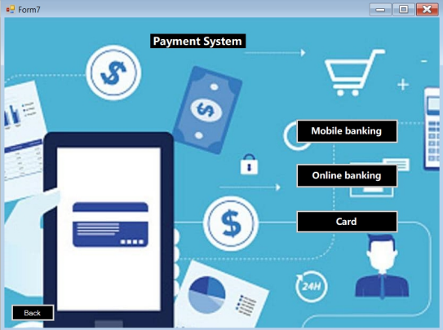
MOCK DESIGN

Slide 12
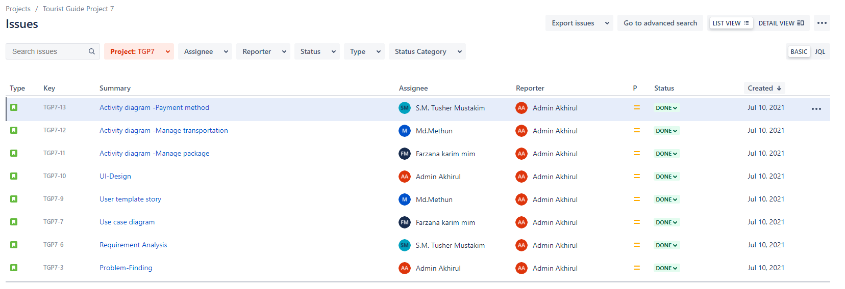
JIRA ISSUES

Slide 13
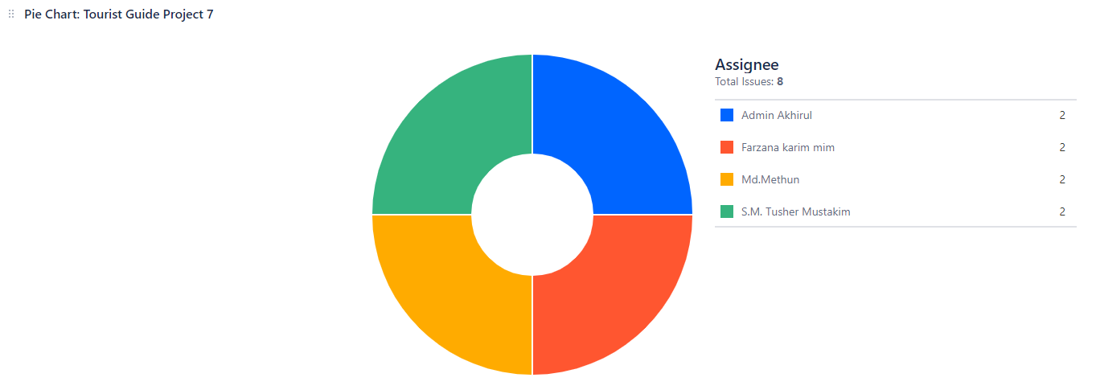
JIRA CONTRIBUTION PIE CHART

Slide 14
Git
Git init
Git status
Git add
Git commit
Git push
Git fetch
Git pull
Git clone

Slide 15
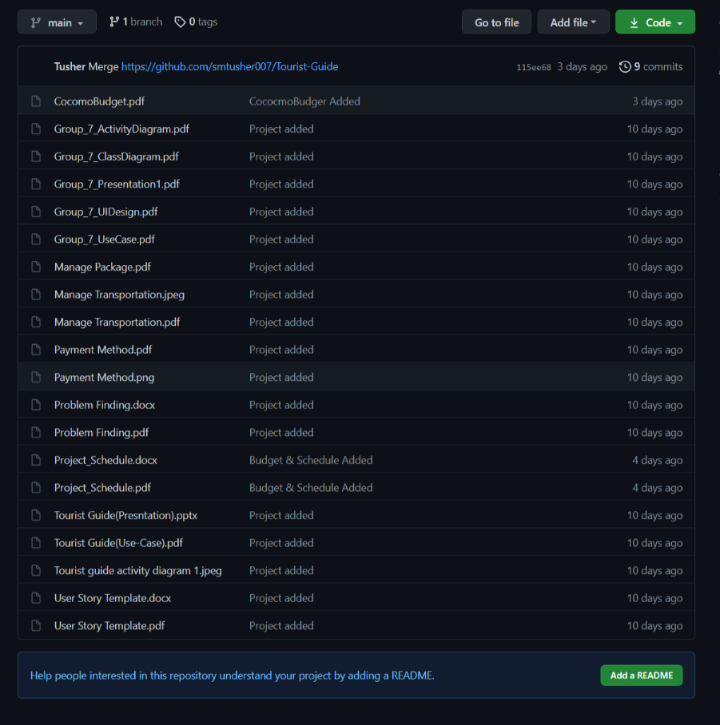
GitHub
Remote repository

Slide 16
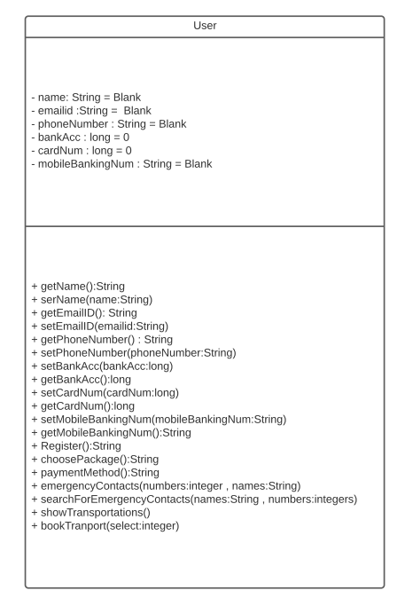
CLASS DIAGRAM-1

Slide 17
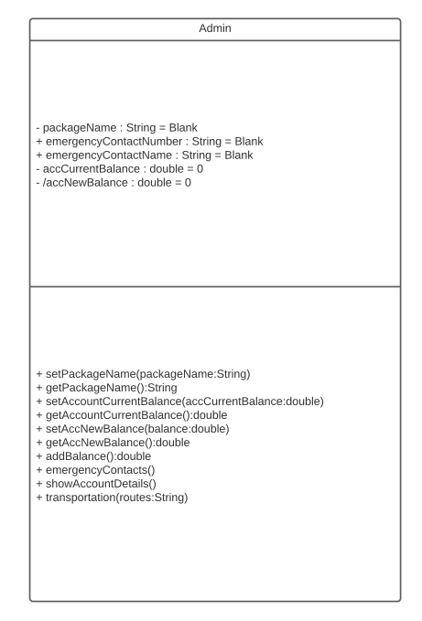
CLASS DIAGRAM-2

Slide 18
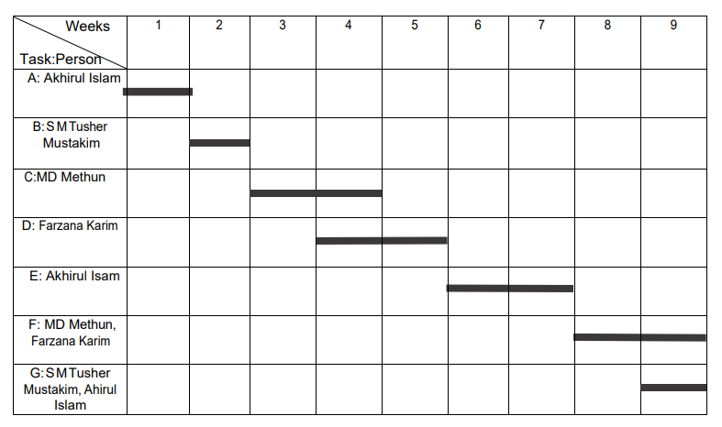
PROJECT SEHEDULING

Slide 19
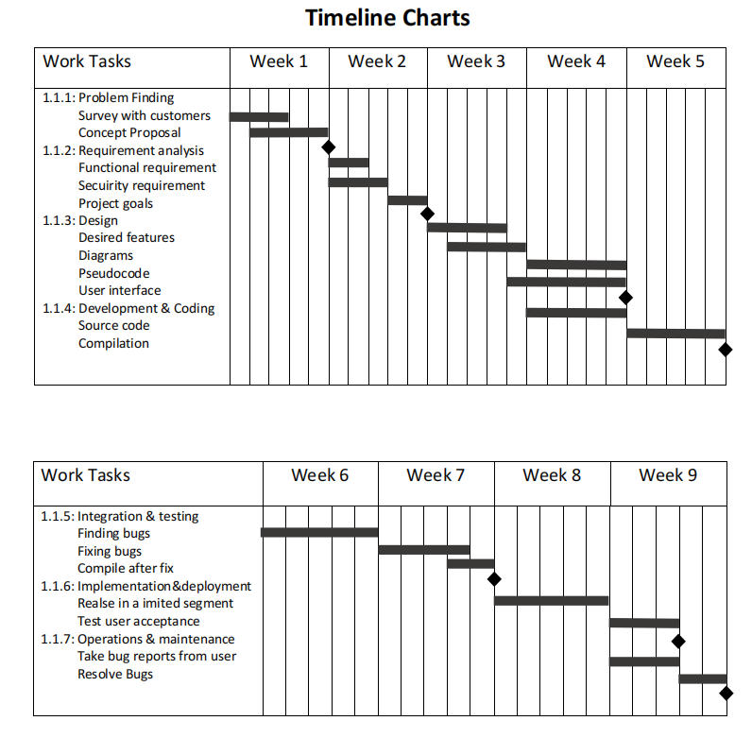
PROJECT SEHEDULING

Slide 20
CONSTRUCTIVE MODEL FOR TOURIST GUID SYSTEM:
Porject Type : Organic
Coefficient : 2.4[P=1.05; T=0.38]
SLOC (Source line of code) : 5000 Lines
Person Months, PM : (2.4*(5000/1000)1.05) =13.005
Development Time, DM : (2.5*13.0050.38) =6.626 =7Months =1232 Working Hour
Required People, ST : PM/DM= 1.85 = 2 People

Slide 21
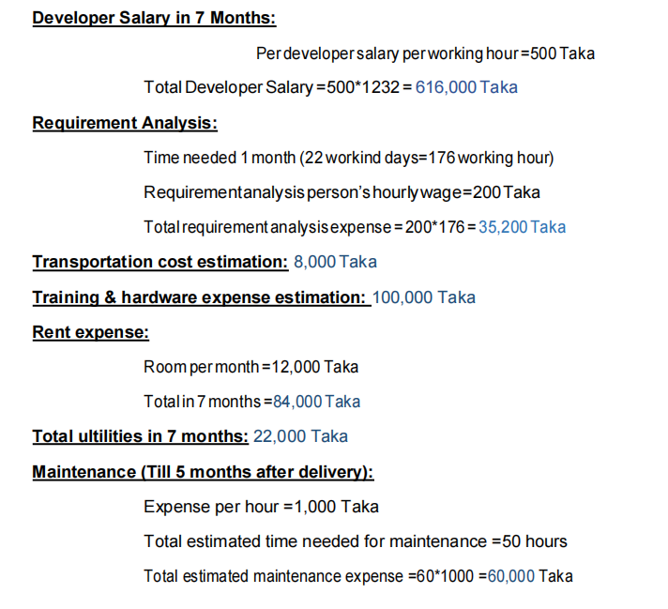
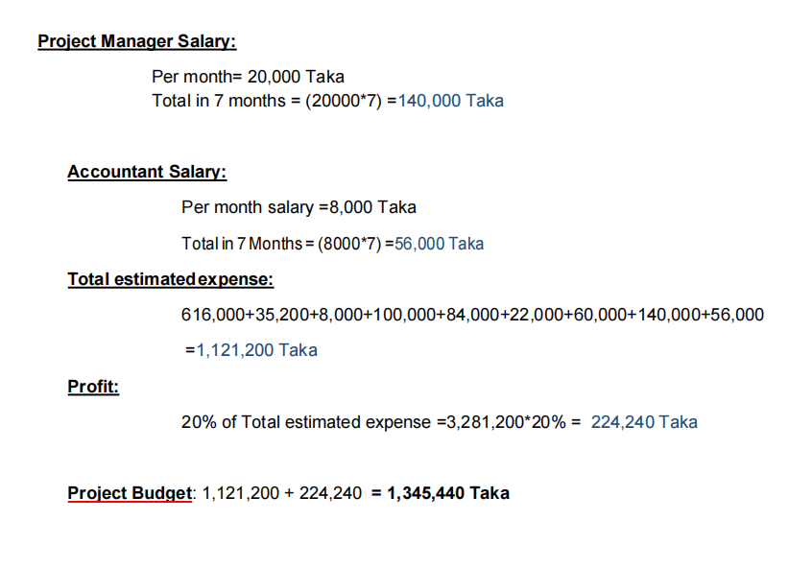
BUDGETING

Slide 22
CONCLUSION
Easy functionality
User Friendly UI design
Team work in different platform
Project management
Efficient project schedule
Moderate budgeting

Slide 23


